Slide 1

MIAI 504
Neural networks and deep learning
  MIAI – 2026/2027
Dr. Zein Al Abidin IBRAHIM
zein.ibrahim@ul.edu.lb

Slide 2
Shallow & Deep Networks

Slide 3
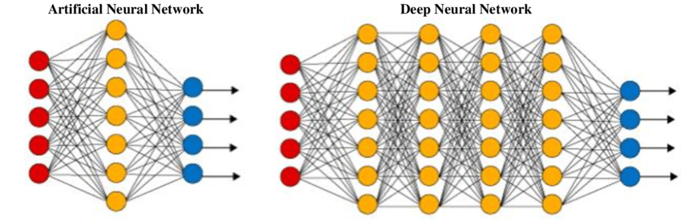
Types of networks
Two main type of networks
  Shallow neural networks
  Deep (very deep, …) neural networks

Slide 4
Shallow networks
Shallow neural networks
  consist of one to two hidden layers between the input and output layers.
  Simpler and easier to train compared to deep neural networks but are usually less capable of capturing complex patterns in data.
Characteristics
  Number of Layers: Usually 1-2 hidden layers.
  Complexity: Lower complexity, easier to interpret.
  Training Time: Generally faster to train due to fewer parameters.
  Applications: Suitable for simpler tasks where the relationships in the data are relatively straightforward. Commonly used in situations where the amount of data is limited, or interpretability is important.
Examples
  Perceptrons: The most basic form of neural networks.
  Multilayer Perceptrons (MLP): If it has one or two hidden layers, it's considered a shallow network.

Slide 5
Deep networks
Deep neural networks
  have multiple hidden layers between the input and output. The term "deep" refers to the depth of these layers.
  can model more complex patterns but require more data and computational resources to train.
Characteristics
  Number of Layers: Usually more than 2 hidden layers. modern architectures can have dozens or even hundreds of layers
  Complexity: Higher complexity, capable of capturing intricate patterns and representations.
  Training Time: Longer training times due to increased number of parameters and complexity, often requiring specialized hardware like GPUs.
  Applications: Suitable for complex tasks such as image and speech recognition, natural language processing, and any application requiring the modelling of high-dimensional data.
Examples
  CNN, RNN (LSTM, BLSTM, GRU), GAN, Transformers, ResNet, DenseNet …
Notes:
https://www.datacamp.com/tutorial/introduction-to-deep-neural-networks

Slide 6
Convolutional neural networks
DEEP LEARNING

Slide 7
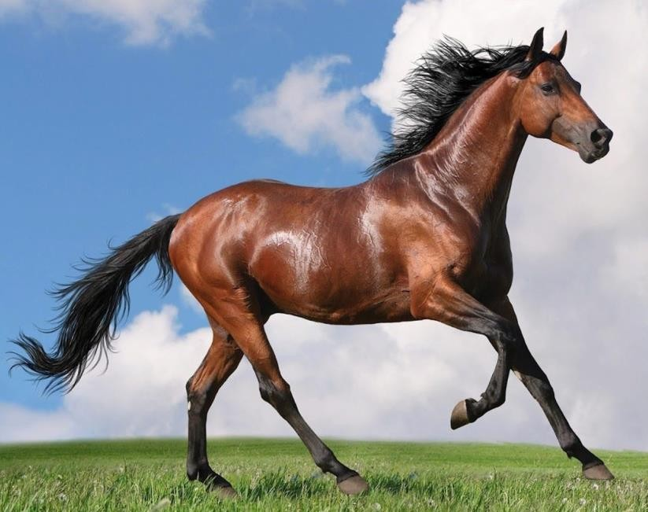
Deep Neural networks problematics
Image size = 500x500x3
Input dimension = 500*500*3=750000
Number of neurons in the first hidden layer
= 100
->Number of weights for the first hidden layer
= 750000*100 = 75 million !!!
7
Notes:
https://towardsdatascience.com/a-comprehensive-guide-to-convolutional-neural-networks-the-eli5-way-3bd2b1164a53

Slide 8
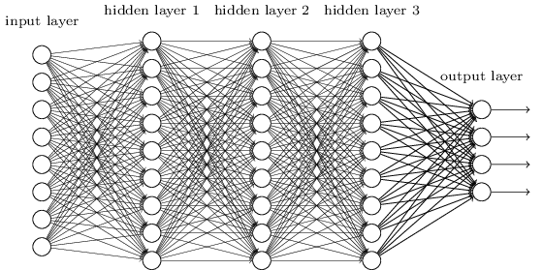
Utility of fully connected layers
We know it is good to learn a small model.
From this fully connected model, do we really need all the edges?
Can some of these be shared?

Slide 9
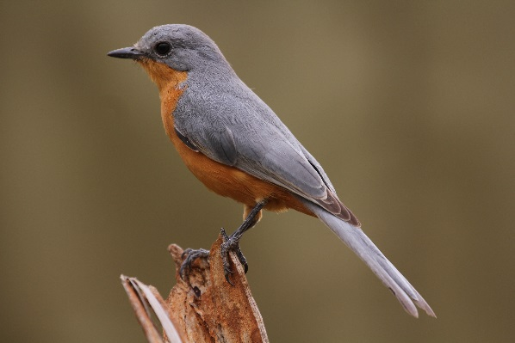
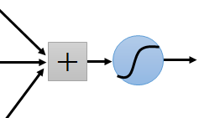
Consider learning an image
Some patterns are much smaller than the whole image
Can represent a small region with fewer parameters
“beak” detector

Slide 10
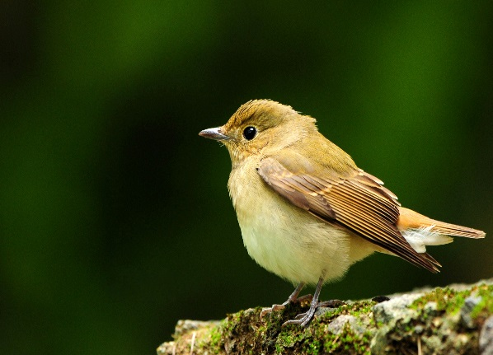
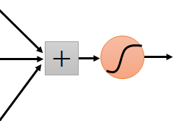
Same pattern appears in different places:
They can be compressed!
What about training a lot of such “small” detectors and each detector must “move around”.
“upper-left beak” detector
They can be compressed
to the same parameters.
“middle beak” detector

Slide 11
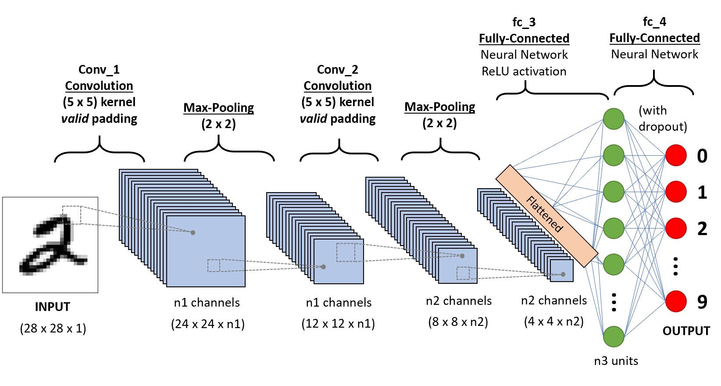
Convolution Neural Networks
A convolution neural network (CNN) is an MLP designed to recognize two-dimensional shapes with a high degree of invariance to translation, scaling and skewing and other sorts of distortion.
They are mostly used in computer vision applications.
11

Slide 12
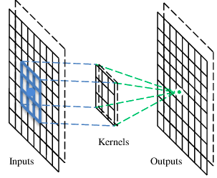
A convolutional layer
A CNN is a neural network with some convolutional layers (and some other layers).
A convolutional layer has a number of filters that does convolutional operation.
Beak detector
A filter

Slide 13
Convolution
These are the network parameters to be learned.
1 | 0 | 0 | 0 | 0 | 1
0 | 1 | 0 | 0 | 1 | 0
0 | 0 | 1 | 1 | 0 | 0
1 | 0 | 0 | 0 | 1 | 0
0 | 1 | 0 | 0 | 1 | 0
0 | 0 | 1 | 0 | 1 | 0
1 | -1 | -1
-1 | 1 | -1
-1 | -1 | 1
Filter 1
-1 | 1 | -1
-1 | 1 | -1
-1 | 1 | -1
Filter 2
……
6 x 6 image
Each filter detects a small pattern (3 x 3).

Slide 14
Convolution
1 | -1 | -1
-1 | 1 | -1
-1 | -1 | 1
Filter 1
stride=1
1 | 0 | 0 | 0 | 0 | 1
0 | 1 | 0 | 0 | 1 | 0
0 | 0 | 1 | 1 | 0 | 0
1 | 0 | 0 | 0 | 1 | 0
0 | 1 | 0 | 0 | 1 | 0
0 | 0 | 1 | 0 | 1 | 0
Dot
product
3
-1
6 x 6 image

Slide 15
Convolution
1 | -1 | -1
-1 | 1 | -1
-1 | -1 | 1
Filter 1
If stride=2
1 | 0 | 0 | 0 | 0 | 1
0 | 1 | 0 | 0 | 1 | 0
0 | 0 | 1 | 1 | 0 | 0
1 | 0 | 0 | 0 | 1 | 0
0 | 1 | 0 | 0 | 1 | 0
0 | 0 | 1 | 0 | 1 | 0
3
-3
6 x 6 image

Slide 16
Convolution
1 | -1 | -1
-1 | 1 | -1
-1 | -1 | 1
Filter 1
stride=1
1 | 0 | 0 | 0 | 0 | 1
0 | 1 | 0 | 0 | 1 | 0
0 | 0 | 1 | 1 | 0 | 0
1 | 0 | 0 | 0 | 1 | 0
0 | 1 | 0 | 0 | 1 | 0
0 | 0 | 1 | 0 | 1 | 0
3
-1
-3
-1
-3
1
0
-3
-3
-3
0
1
3
-2
-2
-1
6 x 6 image

Slide 17
Convolution
-1 | 1 | -1
-1 | 1 | -1
-1 | 1 | -1
Filter 2
stride=1
Repeat this for each filter
1 | 0 | 0 | 0 | 0 | 1
0 | 1 | 0 | 0 | 1 | 0
0 | 0 | 1 | 1 | 0 | 0
1 | 0 | 0 | 0 | 1 | 0
0 | 1 | 0 | 0 | 1 | 0
0 | 0 | 1 | 0 | 1 | 0
3
-1
-3
-1
-1
-1
-1
-1
-3
1
0
-3
-1
-1
-2
1
Feature
Map
-3
-3
0
1
-1
-1
-2
1
3
-2
-2
-1
6 x 6 image
-1
0
-4
3
Two 4 x 4 images
Forming 2 x 4 x 4 matrix

Slide 18
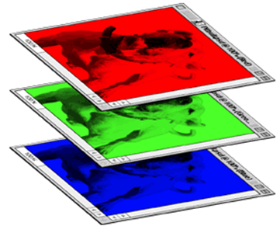
Color image: RGB 3 channels
1 | -1 | -1
-1 | 1 | -1
-1 | -1 | 1
-1 | 1 | -1
-1 | 1 | -1
-1 | 1 | -1
1 | -1 | -1
-1 | 1 | -1
-1 | -1 | 1
-1 | 1 | -1
-1 | 1 | -1
-1 | 1 | -1
1 | -1 | -1
-1 | 1 | -1
-1 | -1 | 1
-1 | 1 | -1
-1 | 1 | -1
-1 | 1 | -1
Filter 1
Filter 2
Color image
1 | 0 | 0 | 0 | 0 | 1
0 | 1 | 0 | 0 | 1 | 0
0 | 0 | 1 | 1 | 0 | 0
1 | 0 | 0 | 0 | 1 | 0
0 | 1 | 0 | 0 | 1 | 0
0 | 0 | 1 | 0 | 1 | 0
1 | 0 | 0 | 0 | 0 | 1
0 | 1 | 0 | 0 | 1 | 0
0 | 0 | 1 | 1 | 0 | 0
1 | 0 | 0 | 0 | 1 | 0
0 | 1 | 0 | 0 | 1 | 0
0 | 0 | 1 | 0 | 1 | 0
1 | 0 | 0 | 0 | 0 | 1
0 | 1 | 0 | 0 | 1 | 0
0 | 0 | 1 | 1 | 0 | 0
1 | 0 | 0 | 0 | 1 | 0
0 | 1 | 0 | 0 | 1 | 0
0 | 0 | 1 | 0 | 1 | 0

Slide 19
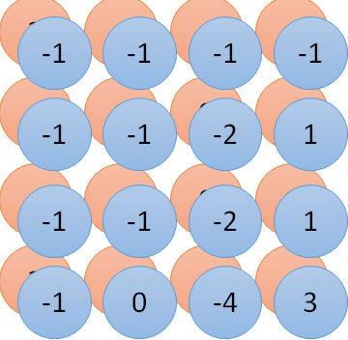
Convolution vs Fully Connected
1 | 0 | 0 | 0 | 0 | 1
0 | 1 | 0 | 0 | 1 | 0
0 | 0 | 1 | 1 | 0 | 0
1 | 0 | 0 | 0 | 1 | 0
0 | 1 | 0 | 0 | 1 | 0
0 | 0 | 1 | 0 | 1 | 0
1 | -1 | -1
-1 | 1 | -1
-1 | -1 | 1
-1 | 1 | -1
-1 | 1 | -1
-1 | 1 | -1
convolution
image
1 | 0 | 0 | 0 | 0 | 1
0 | 1 | 0 | 0 | 1 | 0
0 | 0 | 1 | 1 | 0 | 0
1 | 0 | 0 | 0 | 1 | 0
0 | 1 | 0 | 0 | 1 | 0
0 | 0 | 1 | 0 | 1 | 0
Fully-connected
……
……

Slide 20
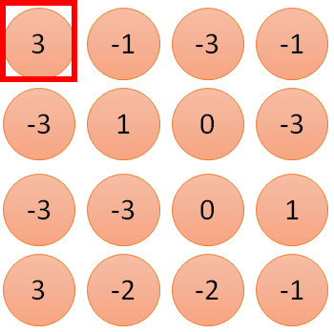
1 | -1 | -1
-1 | 1 | -1
-1 | -1 | 1
1
1
Filter 1
2
0
3
0
3
4:
0
1 | 0 | 0 | 0 | 0 | 1
0 | 1 | 0 | 0 | 1 | 0
0 | 0 | 1 | 1 | 0 | 0
1 | 0 | 0 | 0 | 1 | 0
0 | 1 | 0 | 0 | 1 | 0
0 | 0 | 1 | 0 | 1 | 0
…
0
8
1
9
0
10:
0
…
13
0
6 x 6 image
14
0
Only connect to 9 inputs, not fully connected
fewer parameters!
15
1
16
1
…

Slide 21
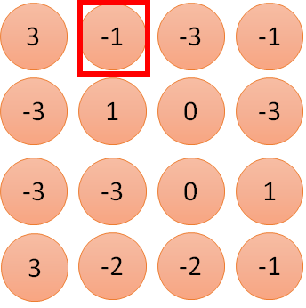
1 | -1 | -1
-1 | 1 | -1
-1 | -1 | 1
1:
1
Filter 1
2:
0
3:
0
3
4:
0
1 | 0 | 0 | 0 | 0 | 1
0 | 1 | 0 | 0 | 1 | 0
0 | 0 | 1 | 1 | 0 | 0
1 | 0 | 0 | 0 | 1 | 0
0 | 1 | 0 | 0 | 1 | 0
0 | 0 | 1 | 0 | 1 | 0
…
7:
0
8:
1
-1
9:
0
10:
0
…
13:
0
6 x 6 image
14:
0
Fewer parameters
15:
1
16:
1
Shared weights
Even fewer parameters
…

Slide 22
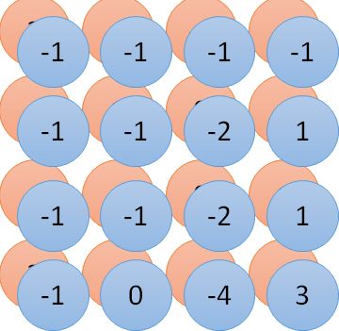










Convolution v.s. Fully Connected
1 | 0 | 0 | 0 | 0 | 1
0 | 1 | 0 | 0 | 1 | 0
0 | 0 | 1 | 1 | 0 | 0
1 | 0 | 0 | 0 | 1 | 0
0 | 1 | 0 | 0 | 1 | 0
0 | 0 | 1 | 0 | 1 | 0
1 | -1 | -1
-1 | 1 | -1
-1 | -1 | 1
-1 | 1 | -1
-1 | 1 | -1
-1 | 1 | -1
convolution
image
x₁
…
…
1 | 0 | 0 | 0 | 0 | 1
0 | 1 | 0 | 0 | 1 | 0
0 | 0 | 1 | 1 | 0 | 0
1 | 0 | 0 | 0 | 1 | 0
0 | 1 | 0 | 0 | 1 | 0
0 | 0 | 1 | 0 | 1 | 0
x₂
Fully- connected
…
…
^{x}36

Slide 23
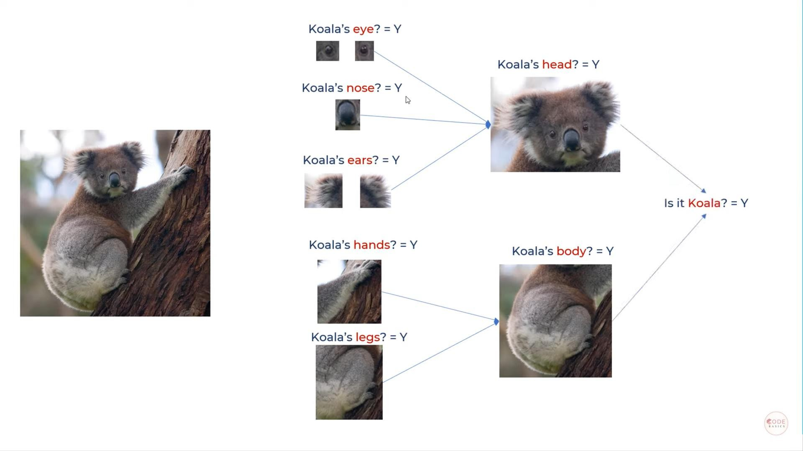
Example

Slide 24
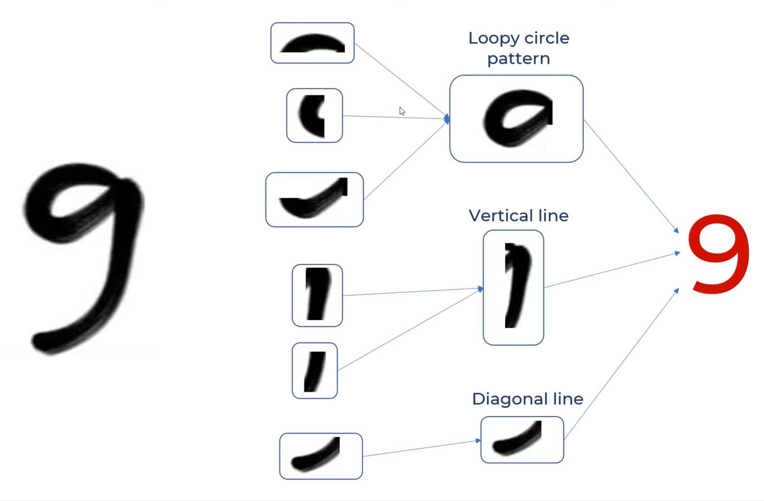
example

Slide 25
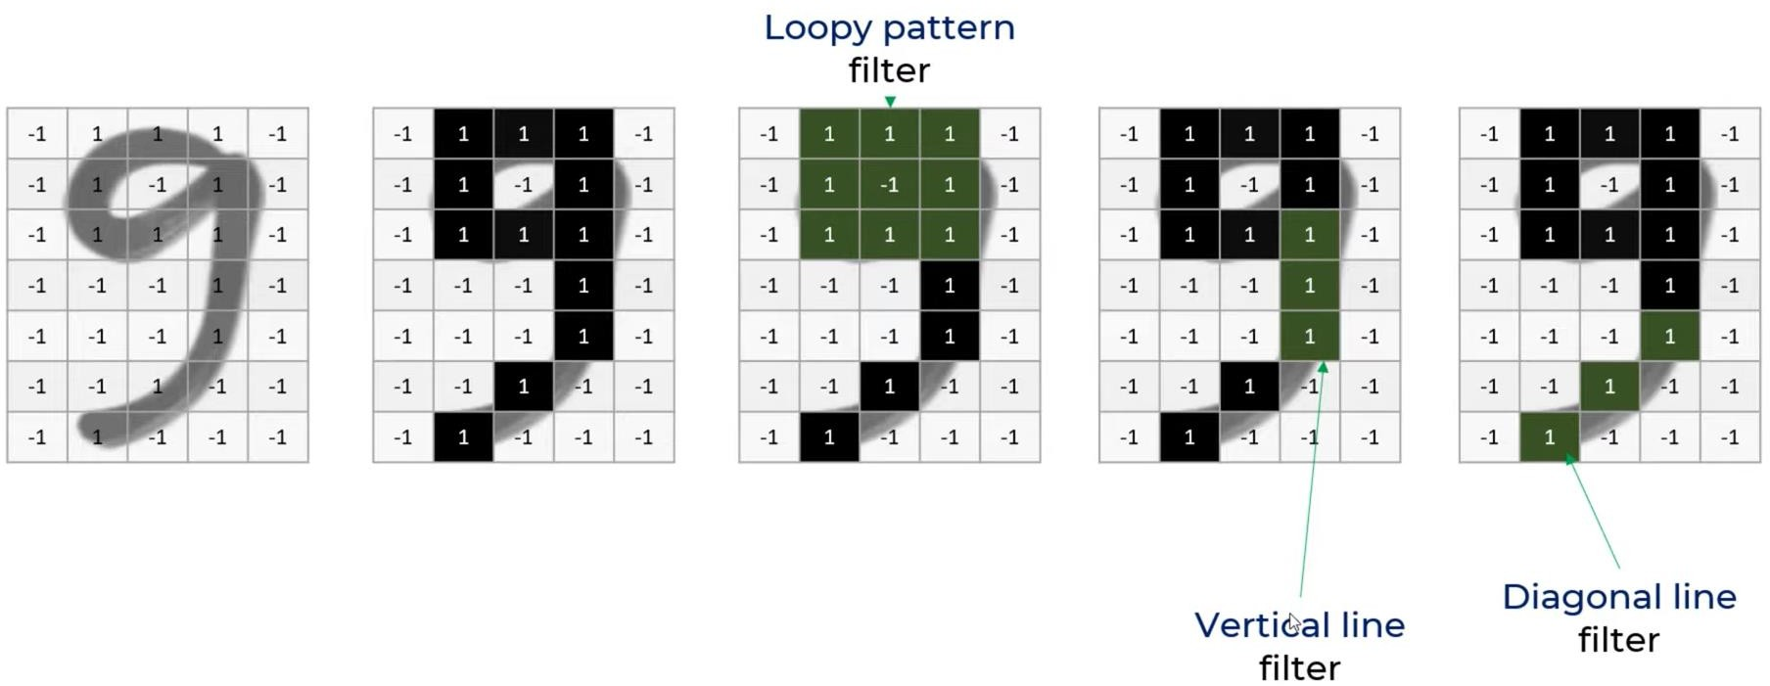

Slide 26
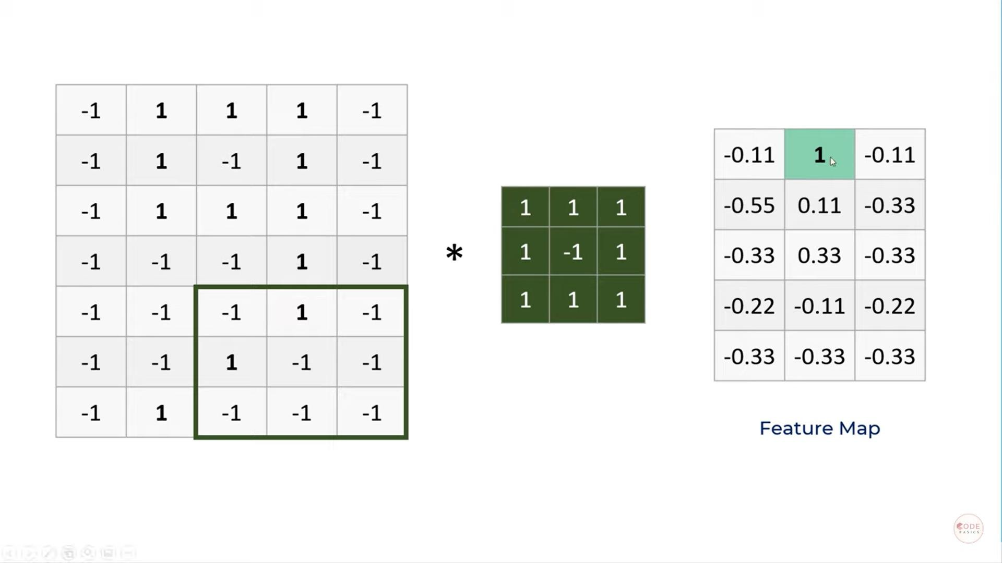

Slide 27
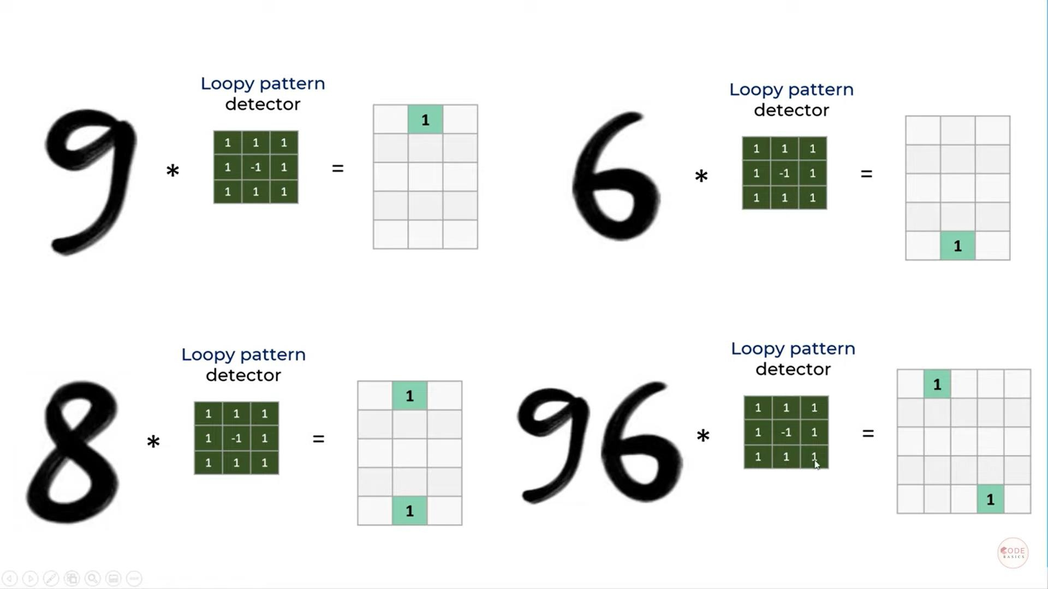

Slide 28
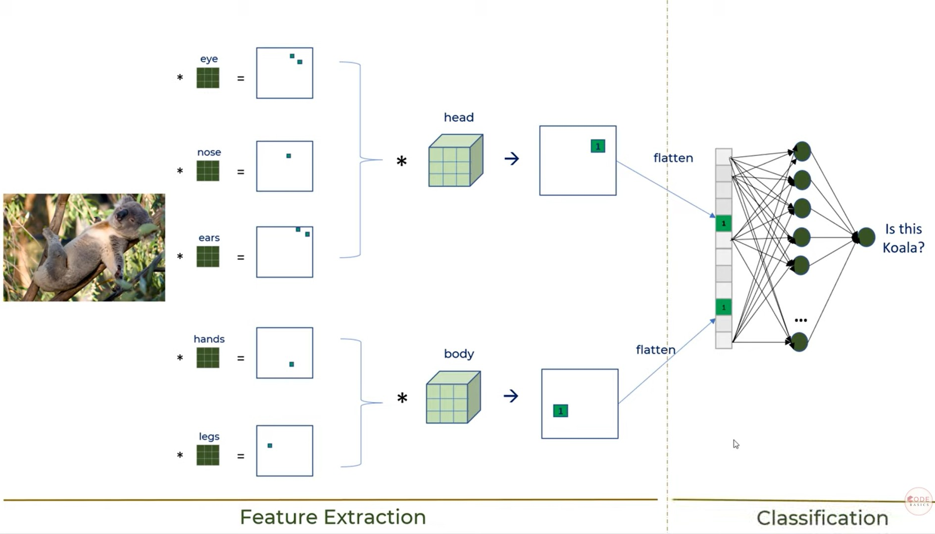

Slide 29
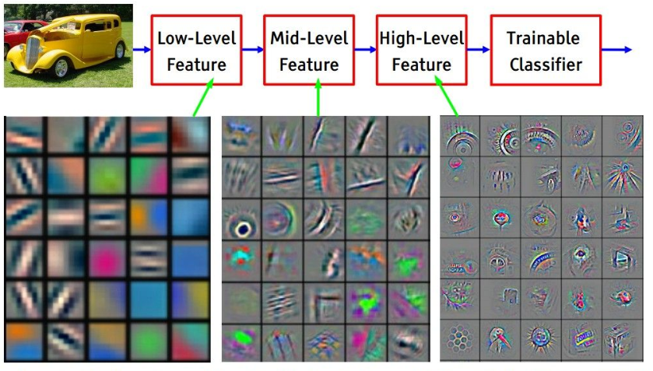

Slide 30
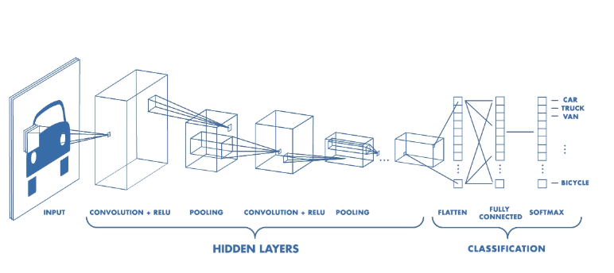
Convolutional Neural Network Elaboration
CNN is mainly used for image recognition and classification.
There are four operations in CNN
  Convolution
  Non-Linearity (ReLU) activation function
  Subsampling or Pooling
  Classification (fully connected layer)

Slide 31
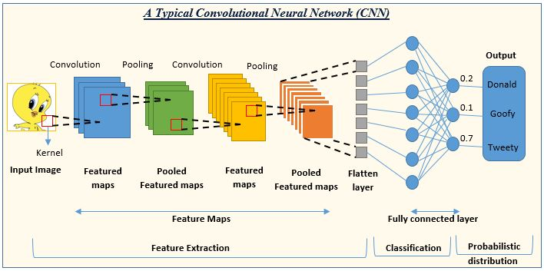
Convolutional Neural Network Elaboration
CNN is mainly used for image recognition and classification.
There are four operations in CNN
  Convolution
  Non-Linearity (ReLU) activation function
  Subsampling or Pooling
  Classification (fully connected layer)

Slide 32
Convolutional Neural Network Elaboration
CNN mainly used for image recognition and classification.
There are four operations in CNN
  Convolution
  Non-Linearity (ReLU) activation function
  Subsampling or Pooling
  Classification (fully connected layer)

Slide 33
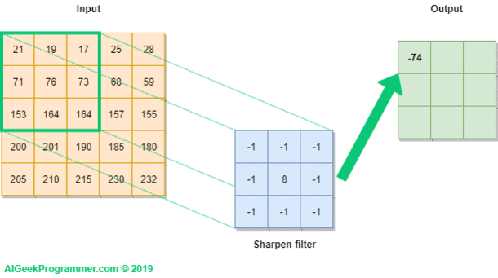
Convolution Operation

Slide 34
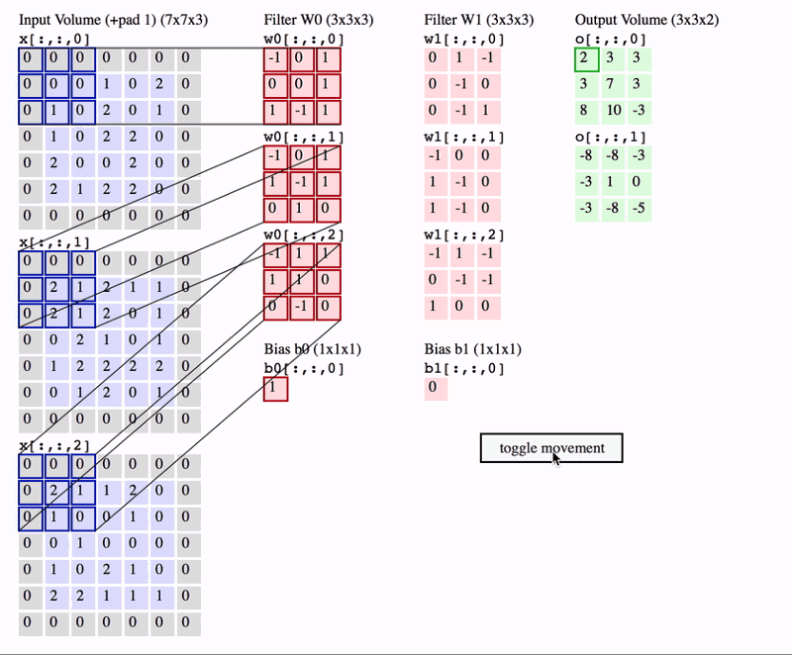

Slide 35
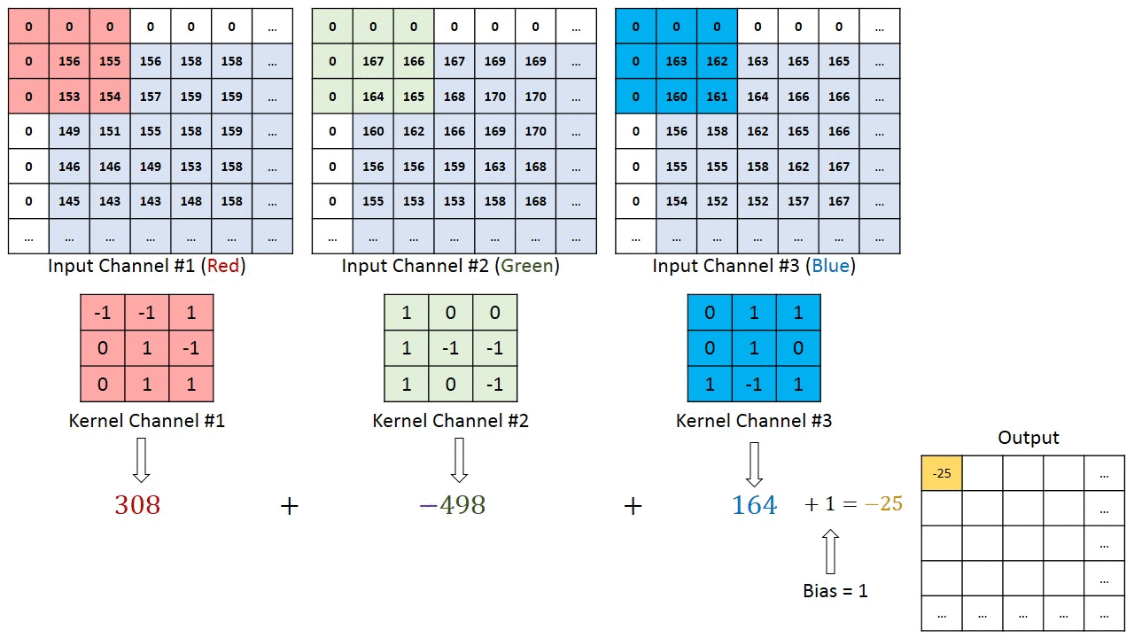
Three-channels image → summing

Slide 36
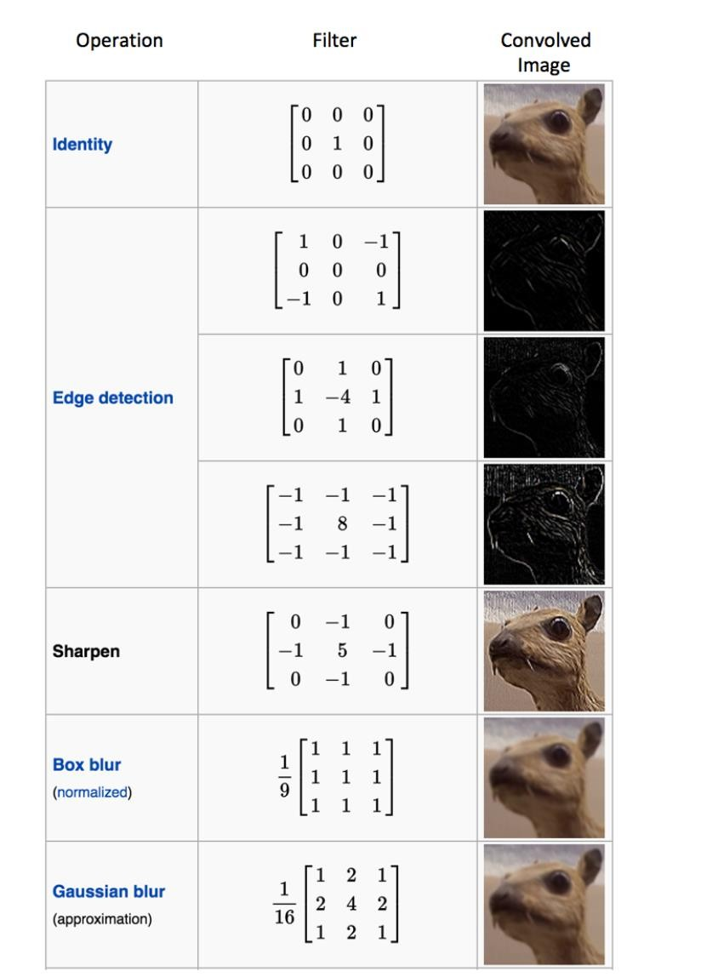
Convolutional Neural Network Elaboration
Convolution
  The 3x3 matrix is called a filter or kernel or feature detector which is applied by sliding (striding).
    The matrix formed is called the feature map.
  Many filters exits such as
    Edge detection
    Blur
    Sharpen
  In a CNN, each filter detect different feature of the input image.
  In practice, a CNN learns the values of these filters on its
own during the training process
    (although we still need to specify parameters such as number of filters, filter size, architecture of the network etc. before the training process).
    The more number of filters we have, the more image features get
extracted and the better our network becomes at recognizing patterns in unseen images.

Slide 37
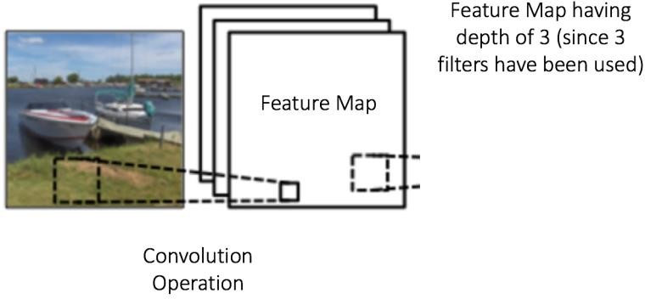
Convolutional Neural Network Elaboration
The size of the Feature Map (Convolved Feature) is controlled by three parameters that we need to specify before the convolution step is performed:
  Depth: Depth corresponds to the number of filters we use for the convolution operation in the network.
In the above figure, we are performing convolution of the original boat image using three distinct filters, thus producing three different feature maps as shown.
You can think of these three feature maps as stacked 2d matrices, so, the ‘depth’ of the feature map would be three.

Slide 38
Convolutional Neural Network Elaboration
Stride is the number of pixels by which we slide our filter matrix over the input matrix.
  When the stride is 1 then we move the filters one pixel at a time.
  When the stride is 2, then the filters jump 2 pixels at a time as we slide them around.
    Having a larger stride will produce smaller feature maps.
Zero-padding: Sometimes, it is convenient to pad the input matrix with zeros around the border, so that we can apply the filter to bordering elements of our input image matrix.

Slide 39
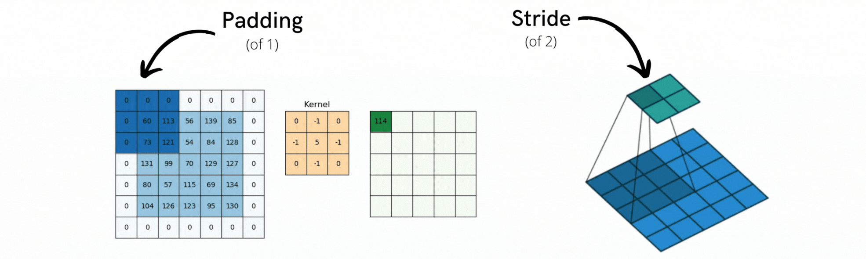
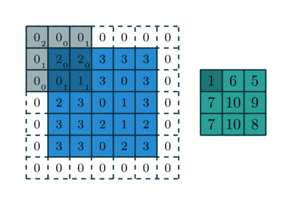
Convolutional Neural Network Elaboration

Slide 40
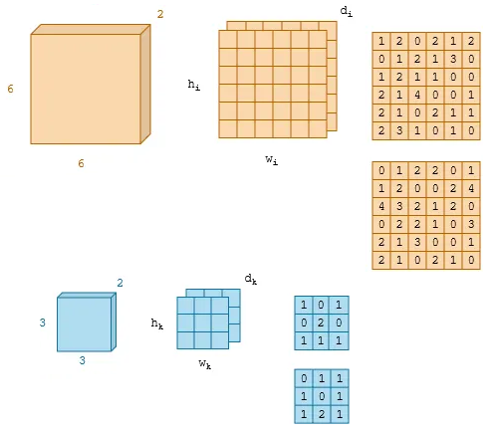

Size of output in terms of inputs
Notes:
https://towardsdatascience.com/a-comprehensible-explanation-of-the-dimensions-in-cnns-841dba49df5e

Slide 41
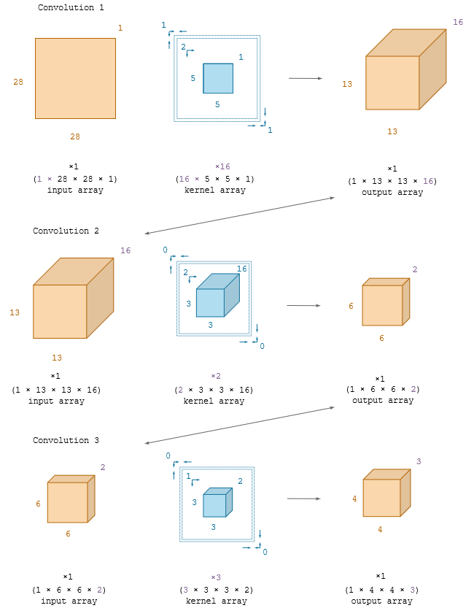
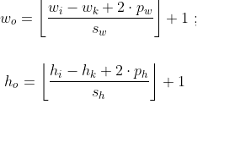
Example

Slide 42
Convolutional Neural Network Elaboration
CNN mainly used for image recognition and classification.
There are four operations in CNN
  Convolution
  Non-Linearity (ReLU) activation function
  Subsampling or Pooling
  Classification (fully connected layer)

Slide 43
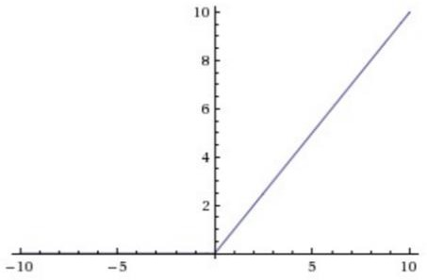
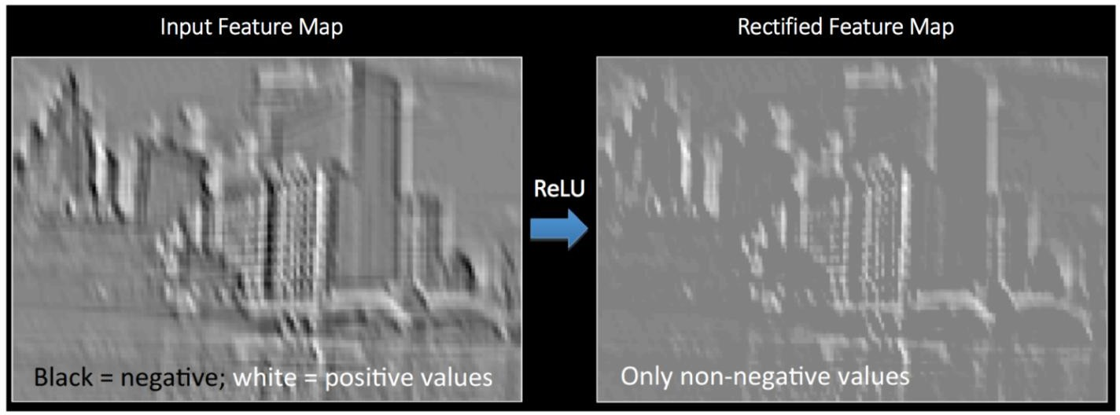
Convolutional Neural Network Elaboration
Non-Linearity (ReLU)
  An additional operation called ReLU has been used after every Convolution operation
  ReLU is an element wise operation (applied per pixel) and replaces all negative pixel values in the feature map by zero. The purpose of ReLU is to introduce non-linearity
  There are non-linear functions such as tanh or sigmoid can also be used instead of ReLU, but ReLU has been found to perform better in most situations.

Slide 44
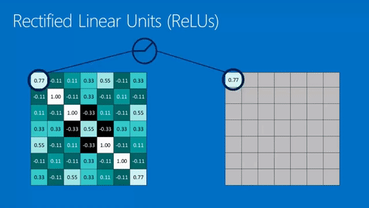
ReLU

Slide 45
Convolutional Neural Network Elaboration
CNN mainly used for image recognition and classification.
There are four operations in CNN
  Convolution
  Non-Linearity (ReLU) activation function
  Subsampling or Pooling
  Classification (fully connected layer)

Slide 46
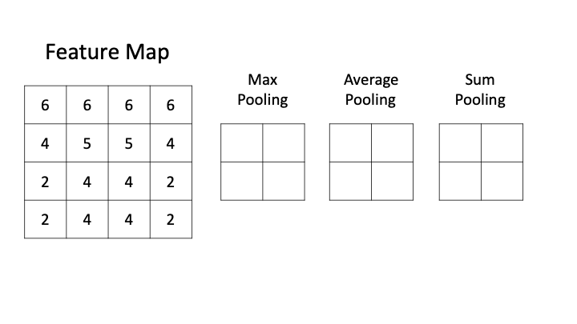
Convolutional Neural Network Elaboration
Subsampling
  Spatial Pooling (also called subsampling or down-sampling) reduces the dimensionality of each feature map but retains the most important information.
  Spatial Pooling can be of different types: Max, Average, Sum etc.

Slide 47
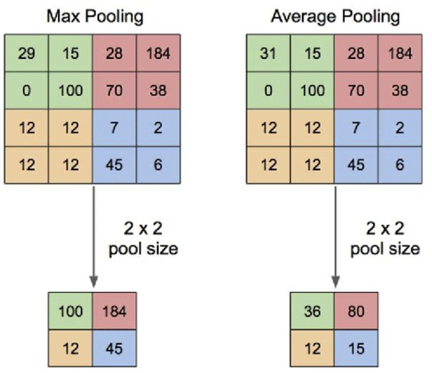
Convolutional Neural Network Elaboration
The below figure shows an example of Max Pool and Average Pool on a rectified image (obtained after convolution + ReLU operation) by using a 2×2 window and stride = 2.
We slide our 2 x 2 window by 2 cells (also called ‘stride’) and take the maximum/average value in each region. As shown in the figure , this reduces the dimensionality of our feature map.

Slide 48
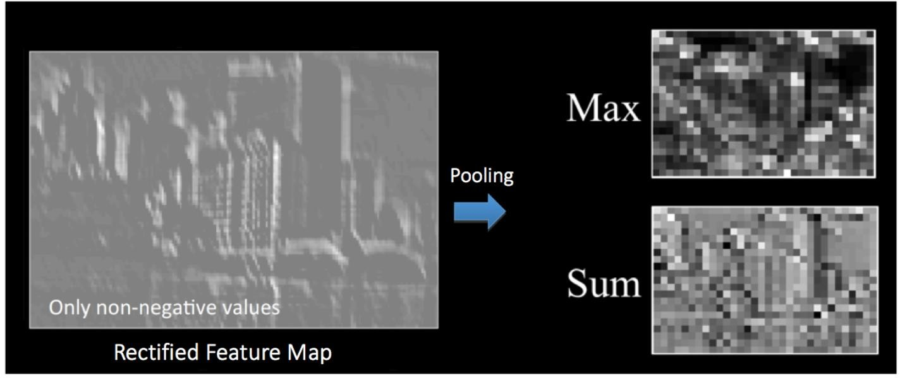
Convolutional Neural Network Elaboration
The below figure shows the effect of Subsampling on the Rectified Feature Map we received after the ReLU operation

Slide 49
Convolutional Neural Network Elaboration
The function of Subsampling is to progressively reduce the spatial size of the input representation. In particular, subsampling
  makes the input representations (feature dimension) smaller and more manageable and reduces the number of parameters and computations in the network, therefore, controlling overfitting.
  makes the network invariant to small transformations, distortions and translations in the input image (a small distortion in input will not change the output of Pooling – since we take the maximum / average value in a local neighbourhood).
  helps us arrive at an almost scale invariant representation of our image (the exact term is “equivariant”). This is very powerful since we can detect objects in an image no matter where they are located.

Slide 50
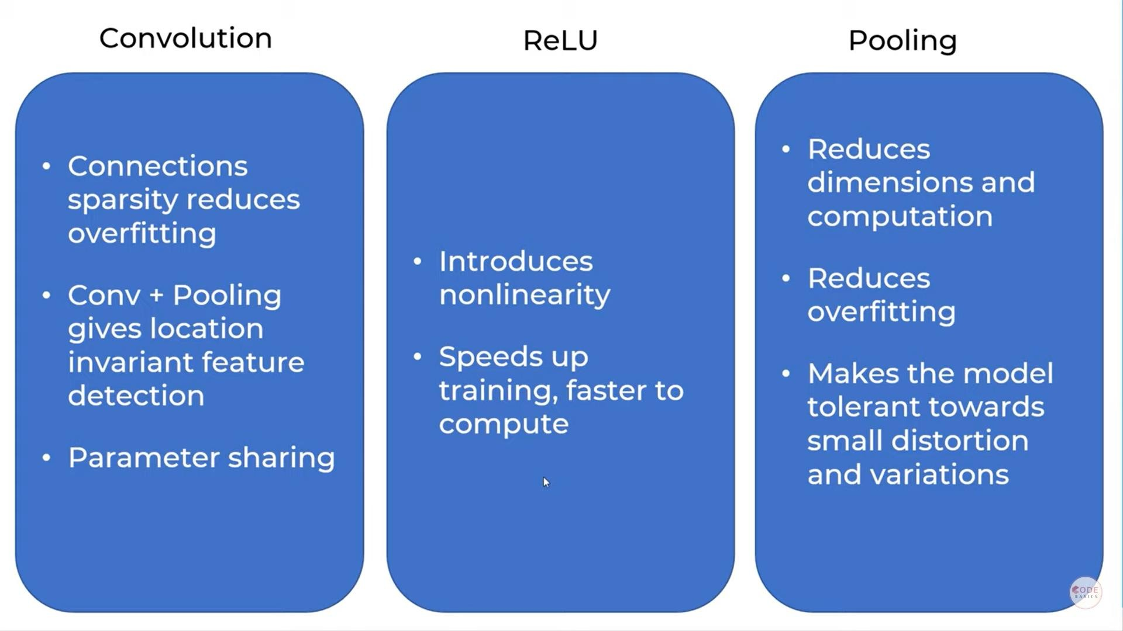

Slide 51
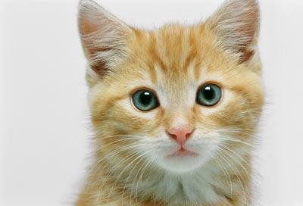



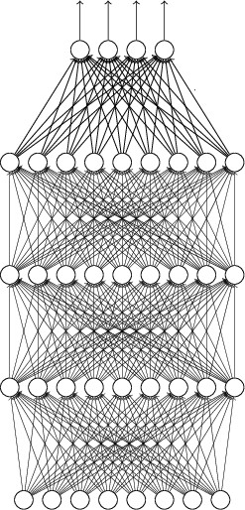


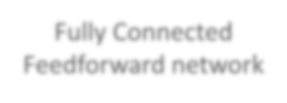








The whole CNN
cat dog ……
Convolution
Max Pooling
Can repeat many times
Fully Connected Feedforward network
Convolution
Max Pooling
Flattened

Slide 52
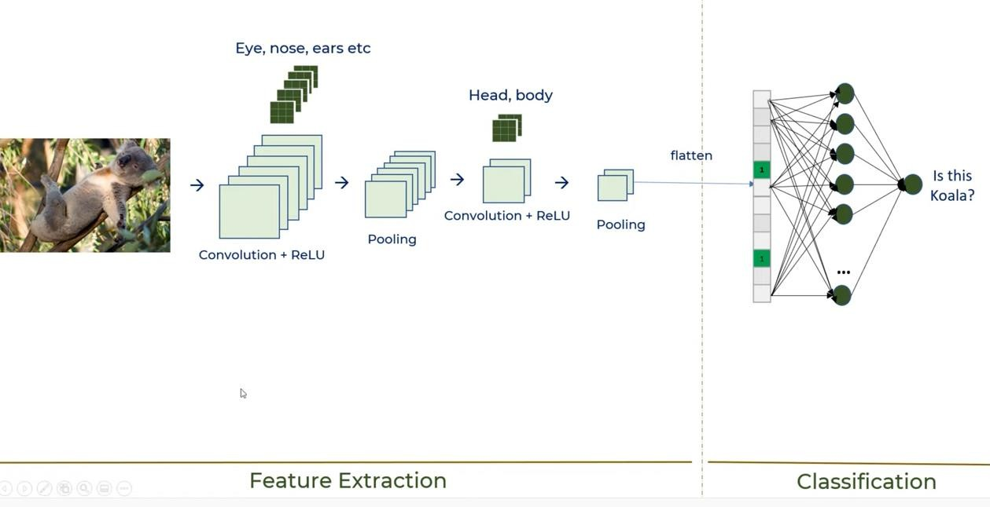

Slide 53
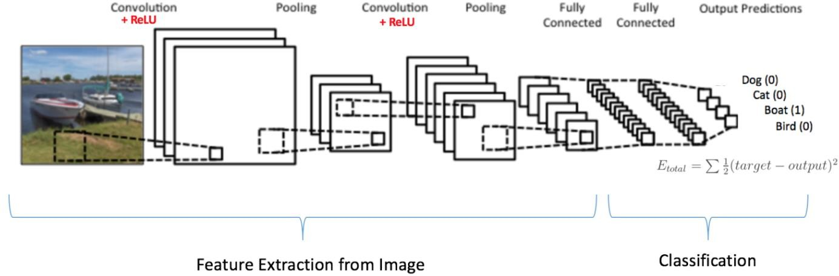
Convolutional Neural Network Elaboration
Putting it all together

Slide 54
Convolutional Neural Network Elaboration
CNN is mainly used for image recognition and classification.
There are four operations in CNN
  Convolution
  Non-Linearity (ReLU) activation function
  Subsampling or Pooling
  Classification (fully connected layer)

Slide 55
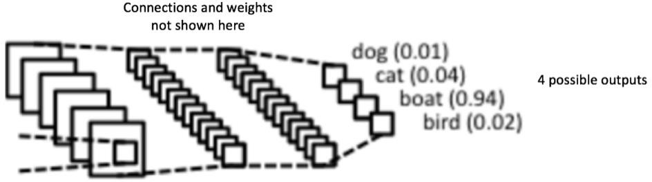
Convolutional Neural Network Elaboration
The Fully Connected layer is a traditional MLP using SoftMax activation function
  The SoftMax function takes a vector of arbitrary real-valued scores and squashes it to a vector of values between zero and one that sum to one.
The output from the convolutional and pooling layers represent high-level features of the input image.
The purpose of the Fully Connected layer is to use these features for classifying the input image into various classes based on the training dataset.

Slide 56
Convolution Networks
Feature extraction:
  Each neuron takes its synaptic inputs from a local receptive field in the previous layer, thereby forcing it to extract local features.
  Once a feature has been extracted, its exact location becomes less important, as long as its position relative to other features is approximately preserved.
Feature mapping
  Each computational layer of the network is composed of multiple feature maps
    Shift invariance, forced into the operation of a feature map through the use of convolution with a kernel of small size, followed by a nonlinear function (sigmoid, RELU, …);
    Reduction in the number of parameters, accomplished through the use of weight sharing.

Slide 57
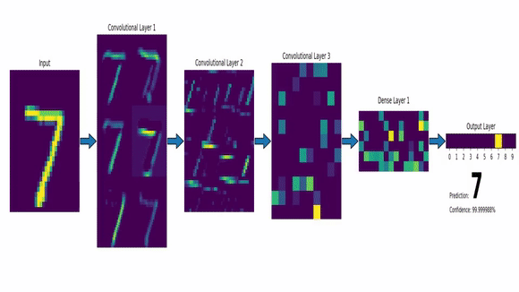

Slide 58
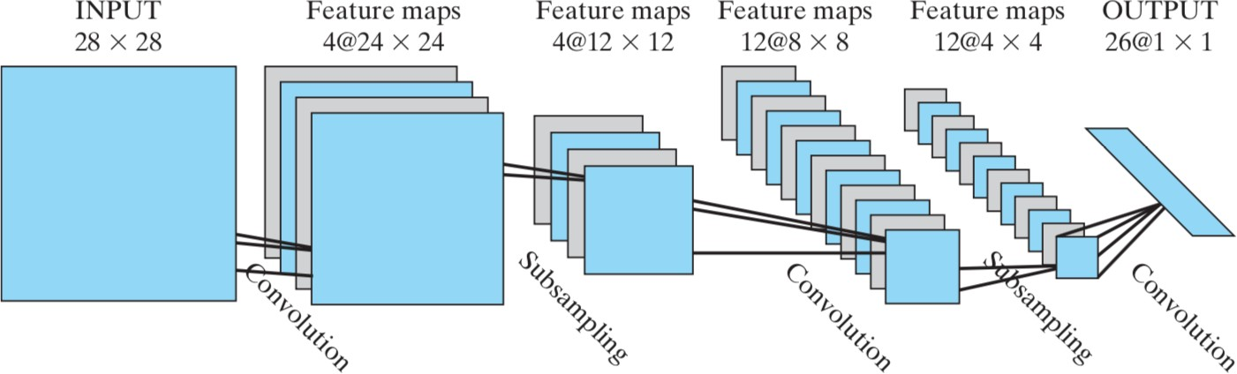
CNN example
The below convolution network is made up of four hidden layers and an output layer.
The input layer is 28 x 28 sensory nodes receiving images of different characters that have been approximately centred and normalized

Slide 59
CNN example
The first hidden layer performs convolution. It consists of four feature maps, with each feature map consisting of 24 x24 neurons.
  Each neuron is assigned a receptive field of size 5 x 5.
The second hidden layer performs subsampling and local averaging. It also consists of four feature maps, but each feature map is now made up of 12 x 12 neurons.

Slide 60
CNN example
The third hidden layer performs a second convolution.
  It consists of 12 feature maps, with each feature map consisting of 8 x 8 neurons.
  Each neuron in this hidden layer may have synaptic connections from several feature maps in the previous hidden layer.
  Otherwise, it operates in a manner similar to the first convolutional layer.
The fourth hidden layer performs a second subsampling and local averaging.
  It consists of 12 feature maps, but with each feature map consisting of 4 x 4 neurons.
  Otherwise, it operates in a manner similar to the first subsampling layer.
The output layer performs one final stage of convolution.
  It consists of 26 neurons, with each neuron assigned to one of 26 possible characters.
  As before, each neuron is assigned a receptive field of size 4 x 4.

Slide 61
CNN example
The MLP shown below contains approximately 100,000 synaptic connection, but only 2600 synaptic weight
  This is done by weight sharing
  The capacity of the learning machine is thereby reduced, which in turn improves the machine’s ability to generalize.
  The adjustment of the parameters are done using stochastic mode of the BP algorithm.

Slide 62
Convolutional Neural Network Training
Step1: We initialize all filters and parameters / weights with random values
Step2: The network takes a training image as input, goes through the forward propagation step (convolution, ReLU and subsampling operations along with forward propagation in the Fully Connected layer) and finds the output probabilities for each class.
  Let's say the output probabilities are [0.2, 0.4, 0.1, 0.3]
  Since weights are randomly assigned for the first training example, output probabilities are also random.
Step3: Calculate the total error at the output layer (summation over all 4 classes)
  Total Error = ∑ ½ (target probability – output probability) ²

Slide 63
Convolutional Neural Network Training
Step4: Use Backpropagation to calculate the gradients of the error with respect to all weights in the network and use gradient descent to update all filter values / weights and parameter values to minimize the output error.
  The weights are adjusted in proportion to their contribution to the total error.
  When the same image is input again, output probabilities might now be [0.1, 0.1, 0.7, 0.1], which is closer to the target vector [0, 0, 1, 0].
This means that the network has learnt to classify this particular image correctly by adjusting its weights / filters such that the output error is reduced.
Parameters like number of filters, filter sizes, architecture of the network etc. have all been fixed before Step 1 and do not change during training process – only the values of the filter matrix and connection weights get updated.
Step5: Repeat steps 2-4 with all images in the training set.

Slide 64
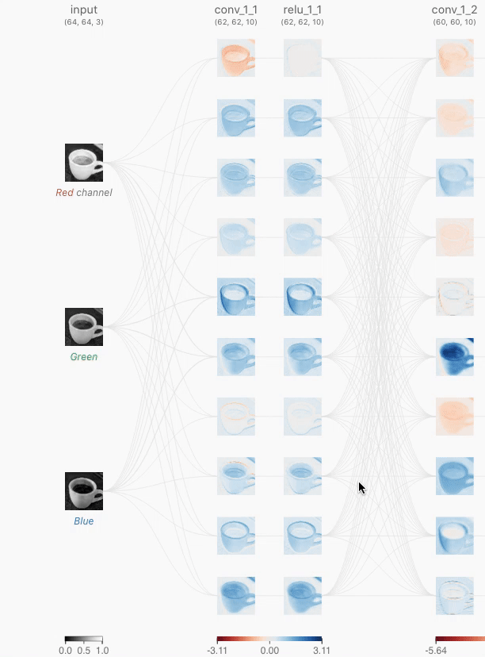

Slide 65
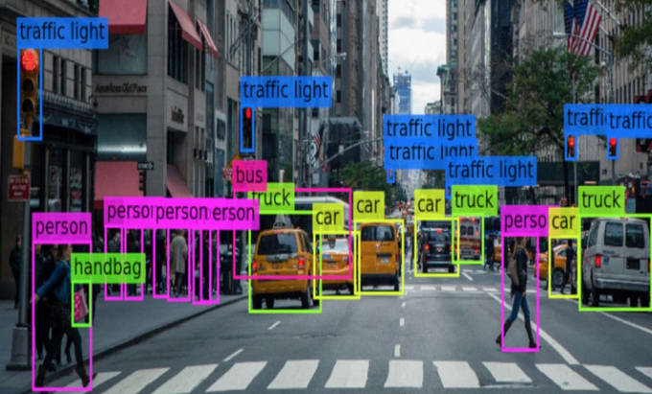
Architectures vs Applications
Image classification
  AlexNet
  VGG (e.g., VGG16, VGG19)
  GoogLeNet (also known as Inception)
  ResNet (e.g., ResNet50, ResNet101)
  DenseNet
  MobileNet
Object detection
  R-CNN (e.g., Fast R-CNN, Faster R-CNN)
  YOLO (You Only Look Once)
  SSD (Single Shot Detector)
  RetinaNet

Slide 66


Architectures vs Applications
Semantic segmentation
  FCN (Fully Convolutional Network)
  U-Net
  SegNet
  DeepLab
Generative modeling
  GAN (Generative Adversarial Network)
  VAE (Variational Autoencoder)
  PixelCNN

Slide 67
Some GAN-based Applications
Image generation: GANs can generate high-quality images of various types, such as human faces, landscapes, and animals. This has applications in art, design, and advertising.
Image-to-image translation: GANs can be used to translate an image from one domain to another, such as converting a daytime image to a nighttime image, or converting a sketch to a photorealistic image.
Super-resolution: GANs can be used to generate high-resolution images from low-resolution images, which has applications in medical imaging, satellite imaging, and surveillance.
Video synthesis: GANs can generate realistic videos by combining generated frames with real frames, which has applications in entertainment and virtual reality.
3D object generation: GANs can generate 3D objects from 2D images, which has applications in manufacturing, prototyping, and product design.
Text-to-image synthesis: GANs can generate images from textual descriptions, which has applications in e-commerce, advertising, and visual storytelling.

Slide 68
Some GAN-based Applications
Style transfer: GANs can be used to transfer the style of one image to another, which has applications in art and design.
Data augmentation: GANs can be used to generate synthetic data to augment real data for training machine learning models, which can improve model accuracy.
Image inpainting: GANs can fill in missing parts of an image based on the surrounding context, which has applications in photo editing and restoration.
Image manipulation: GANs can be used to manipulate images in various ways, such as changing the pose or expression of a person in an image, or changing the background. This has applications in entertainment, advertising, and social media.
Image colorization: GANs can be used to colorize grayscale images, which has applications in photography and art.
Face swapping: GANs can be used to swap faces in images or videos, which has applications in entertainment and social media.
……

